Slide 1
BOSCH RESEARCH SYNC · 2026-06-12
Perspective Images → 360° Panorama
A general multi-camera pipeline from AV ring cameras to a complete-sphere ERP panorama — source-faithful, evidence-gated.
JINGSHUO
Presenter
I
Notes:
Today I will present Neuron-Guided Attacks on Retrieval-Augmented Generation of LLMs via Genetic Optimization of External Knowledge.
This is a NeurIPS 2025 paper on attacking RAGa.
Basically, The central idea is to use neuron-level signals inside the model to optimize poisoned external knowledge.

Slide 2
OPENING
The task — and why Argoverse 2
GOAL
WAYMO OPEN DATASET
ARGOVERSE 2
▸ N synchronized perspective cameras → one 1024×2048 ERP 360° panorama
▸ 5 cameras
▸ ~250° forward arc
▸ rear gap
▸ No full ring from cameras alone
▸ 7 ring cameras = full 360°
▸ 20 Hz · ~300 frames/log
▸ 3D boxes + LiDAR
▸ Per-camera capture timestamps (this became crucial)
Waymo migration stays queued as our generalization gate.
II
Notes:
1. Let me start with the paper's main question.
2. Even if the model already knows the true answer in parametric memory, can poisoned external knowledge still overwrite it at scale? The paper's answer is yes. 3. This result is not from one picked model or one easy dataset. It is observed across four open-source LLMs and three QA benchmarks, and the evolved attack pushes overwrite success above ninety percent. I will introduce those models and benchmarks explicitly later in the setup slide.
4. The attacker cannot change weights or training data, but does have white-box access to activations and Integrated Gradients at inference time. The goal is to replace the true answer with an attacker-chosen false one, while still keeping the passage fluent and low-perplexity.

Slide 3
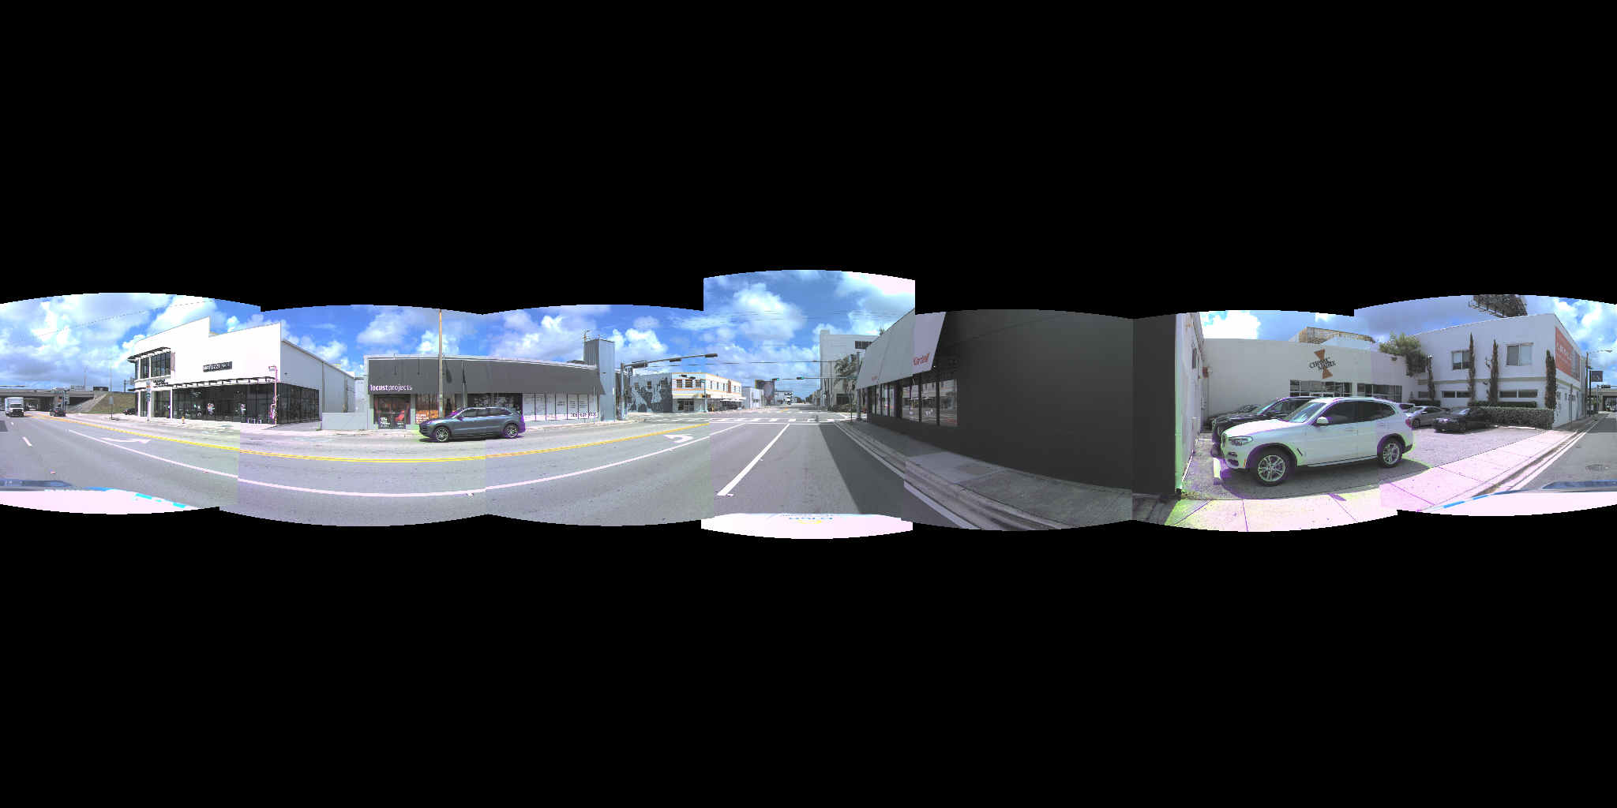
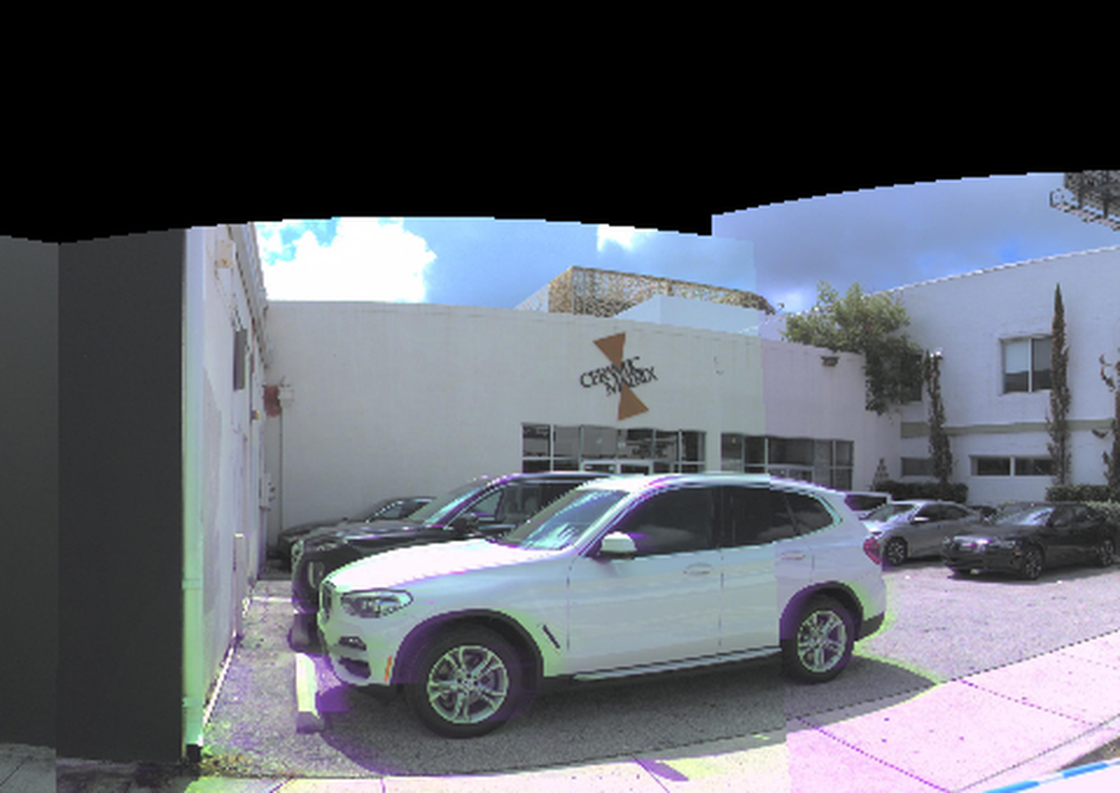
BASELINE
L1 baseline: project and blend — and why it fails
overlap, zoomed
▸ Method: project every camera onto ONE sphere centred at the ego origin, blend the overlaps (multi-band)
▸ Each camera sees the world from a DIFFERENT position — one shared sphere puts their content in slightly different places
▸ Diagnosis: blending = averaging two misaligned copies → ghosting in every overlap; black sky/ground = outside all camera FOVs
III
Notes:
1. This figure gives a clean before-and-after view of RAG.
2. On the left, the retriever returns benign external knowledge, so the model's response stays aligned with its original internal knowledge. On the right, once the retriever surfaces poisoned external knowledge, that external context can override the model's original belief and steer generation toward a poisoned output.
3. So at this stage, the key attack surface is still the retrieved corpus, not the model weights. One caveat matters here: in the paper's experiments, retriever noise is isolated by prompt injection. So this is mainly a generation-side study, not a full end-to-end retrieval attack.

Slide 4
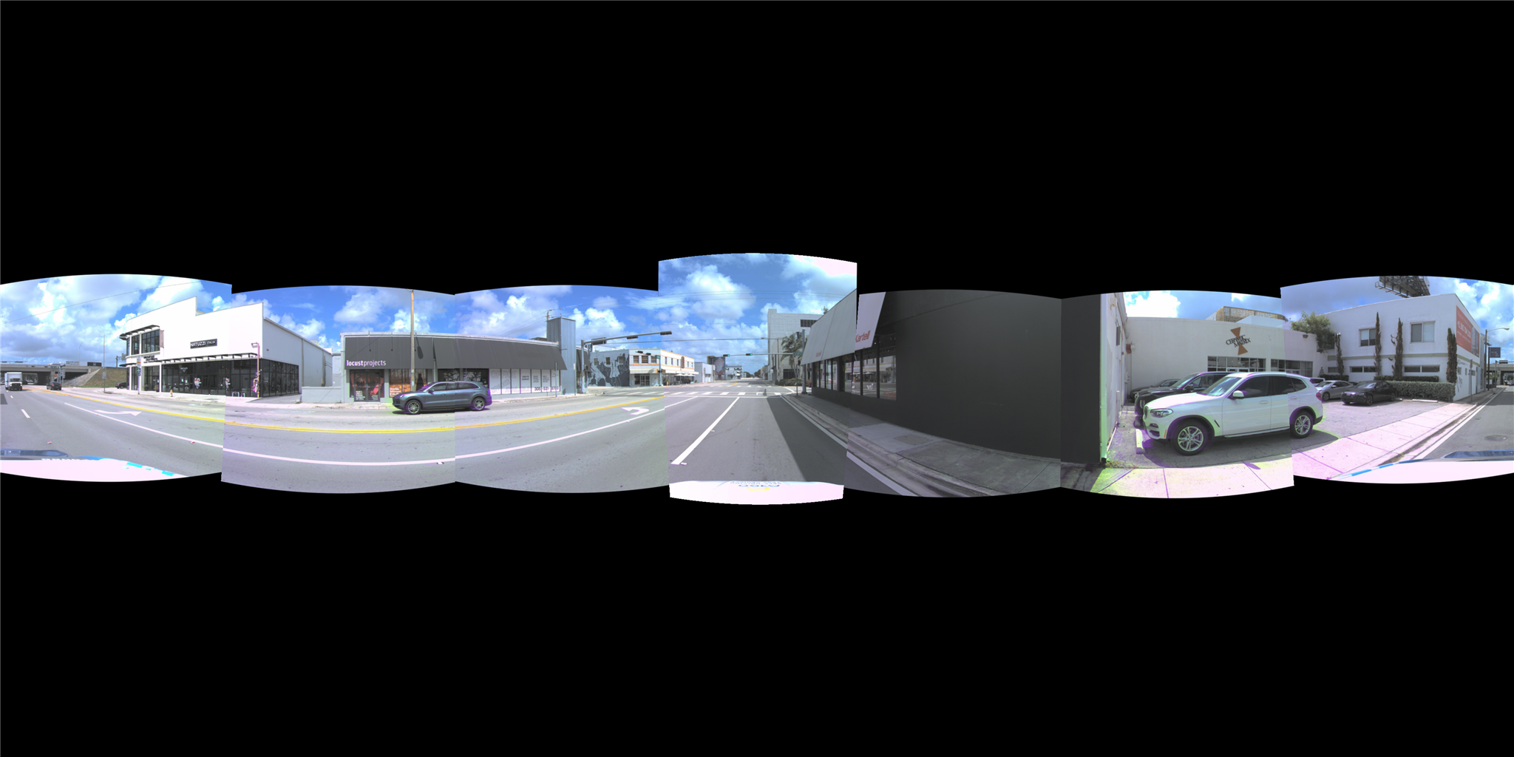
ITERATIONS
Two months of better seam-hiding
Hard select
HOW Same projection as L1; in every overlap each pixel takes exactly ONE camera (no mixing).
WHY IT FAILED It removes the double image, not the misplacement — both copies were in the wrong place; picking one leaves structure that jumps at the seam line (walls, curbs break).
One camera per pixel: color ghosts gone, structure still misaligned
Every route hit the same wall: we were hiding seams, not removing their cause. Learned / 3D replacements tested worse.
IV
Notes:
1. This slide positions the paper against prior attacks.
2. PoisonedRAG is the main experimental compared baseline, but it does not use neuron information. AutoDAN also uses a genetic algorithm, but at the prompt level rather than the external-knowledge level. GCG uses gradients, but mostly for short token triggers.
3. So the novelty here is the combination: genetic optimization, explicit knowledge-conflict handling, and neuron-guided signals.

Slide 5

ITERATIONS
Two months of better seam-hiding
Optical-flow view interpolation
HOW Surround360-style: estimate optical flow between the two cameras inside the overlap strip, warp both toward a middle viewpoint until they agree, then blend.
WHY IT FAILED Flow can only reconcile what both cameras saw consistently — moving cars were photographed at DIFFERENT instants (a time difference, not a viewpoint difference), and textureless/occluded regions have no correct flow → smear.
Smooths determinable seams, helpless on moving objects
Every route hit the same wall: we were hiding seams, not removing their cause. Learned / 3D replacements tested worse.
V
Notes:
1. This slide positions the paper against prior attacks.
2. PoisonedRAG is the main experimental compared baseline, but it does not use neuron information. AutoDAN also uses a genetic algorithm, but at the prompt level rather than the external-knowledge level. GCG uses gradients, but mostly for short token triggers.
3. So the novelty here is the combination: genetic optimization, explicit knowledge-conflict handling, and neuron-guided signals.

Slide 6
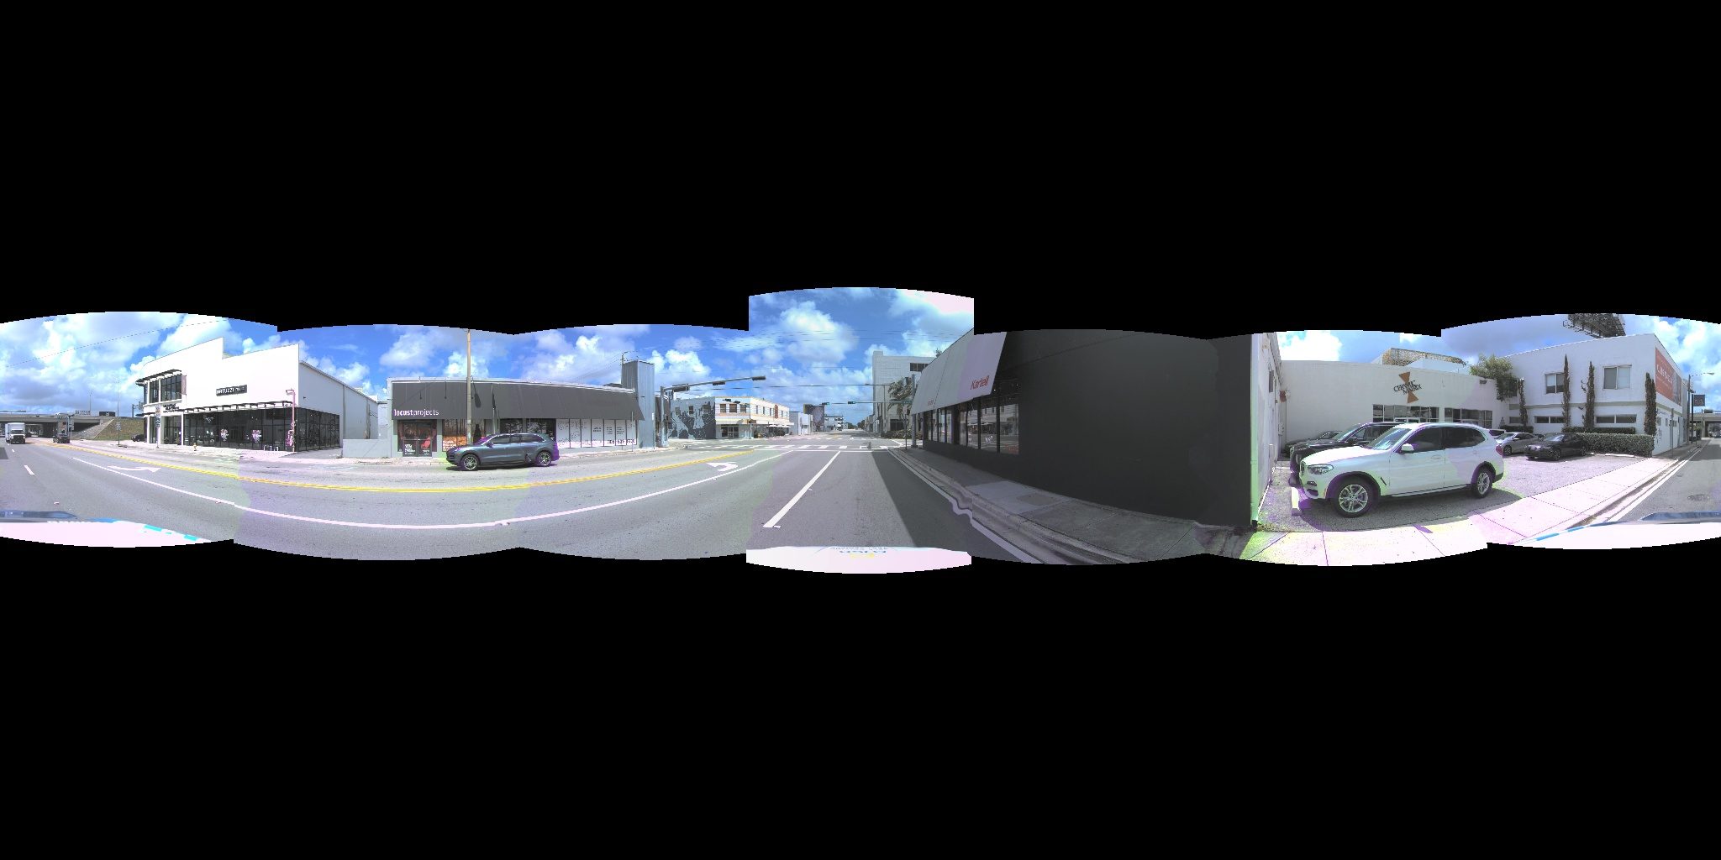
ITERATIONS
Two months of better seam-hiding
Seam routing around objects
HOW Cut the panorama along least-damage paths that detour around objects (min-cut), pick one source region per area from a virtual viewpoint.
WHY IT FAILED The seam is moved, not removed: near the ground every path must cross the road (wavy seams), and a car driving through a seam is split between two cameras = two instants — no route fixes time.
Best of this era — near-ground waviness and seam-cut cars persist
Every route hit the same wall: we were hiding seams, not removing their cause. Learned / 3D replacements tested worse.
VI
Notes:
1. This slide positions the paper against prior attacks.
2. PoisonedRAG is the main experimental compared baseline, but it does not use neuron information. AutoDAN also uses a genetic algorithm, but at the prompt level rather than the external-knowledge level. GCG uses gradients, but mostly for short token triggers.
3. So the novelty here is the combination: genetic optimization, explicit knowledge-conflict handling, and neuron-guided signals.

Slide 7
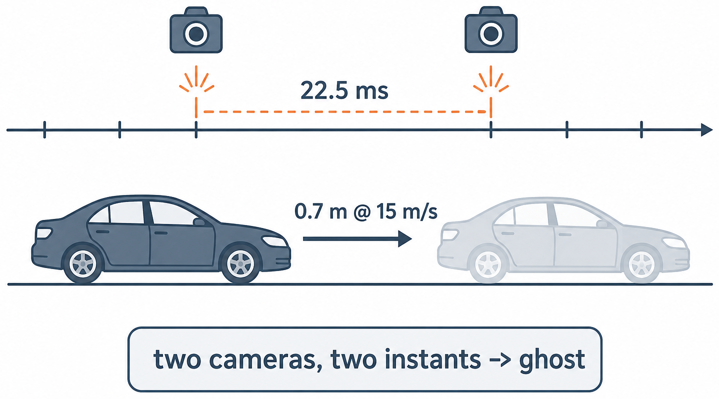
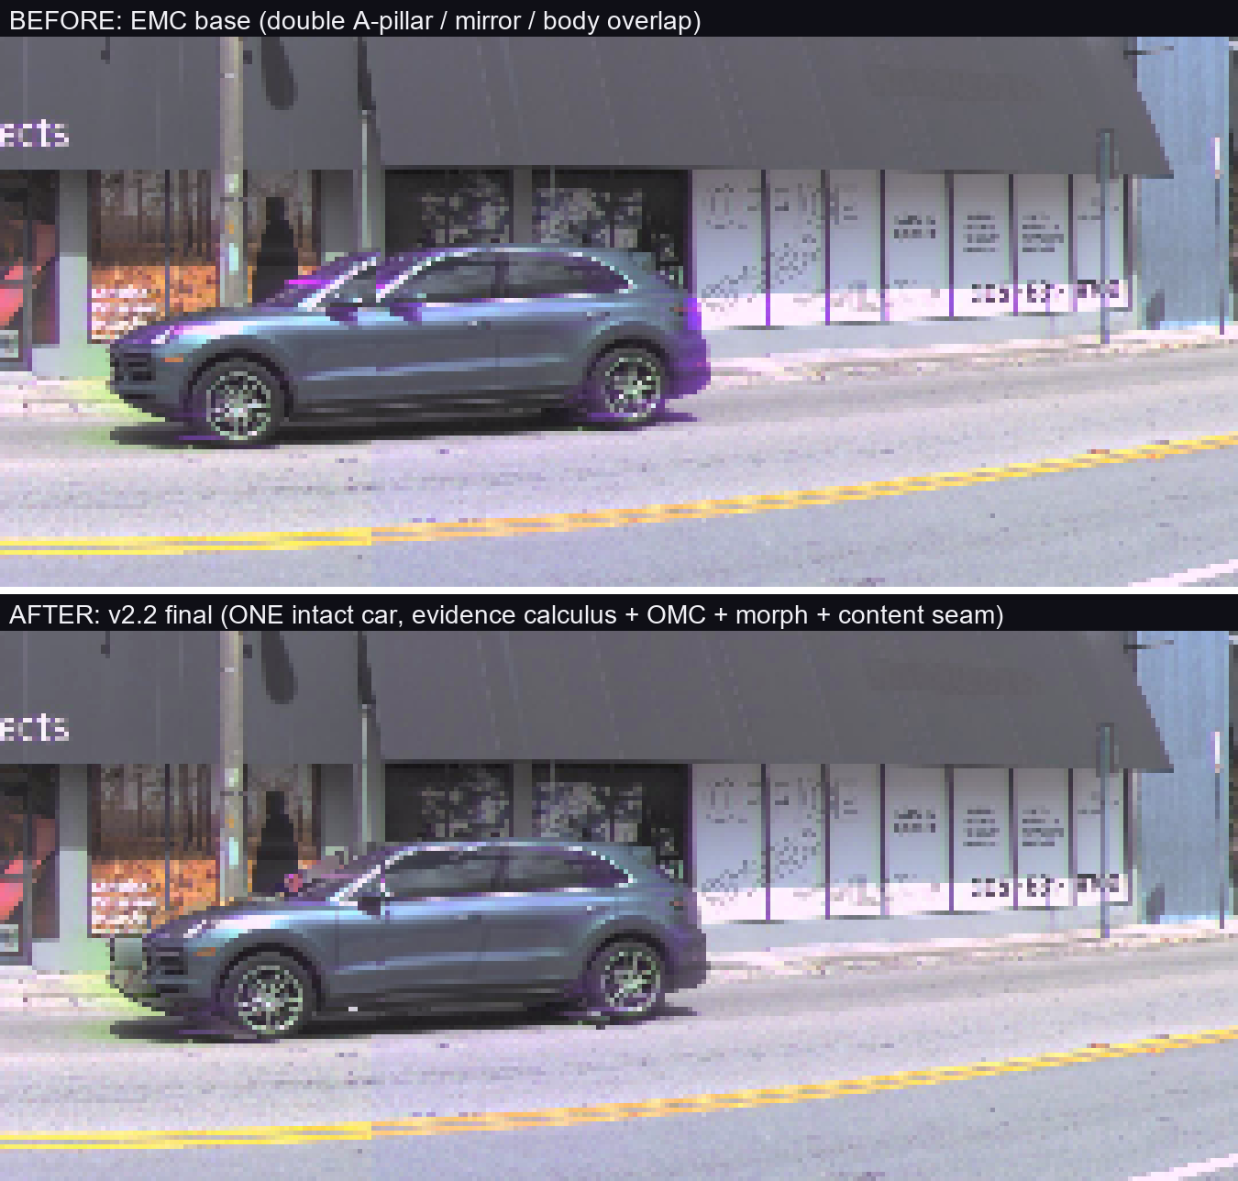
MAIN METHOD · 1/2
Remove the cause: three fixes
① Virtual centre — the projection centre was pinned to the ego origin since day one; nobody questioned it. Moving it to the cameras' own centroid makes every camera's content land where it belongs (projection residuals ↓ 18–96×).
② EMC: per-camera shutter poses — the 7 cameras fire up to ±22.5 ms apart; each image is projected with the ego pose of ITS OWN exposure instant, so the static world aligns exactly.
③ One body · one camera · one time (+OMC) — every moving object is rendered WHOLE from a single camera at a single instant (identity from 3D boxes, geometry from segmentation masks); its residual shutter displacement is measured (ECC, du=+6 px) and compensated. Seam-cut and ghosted cars become impossible by construction.
before / after
VII
Notes:
1. The previous slide showed that existing attacks can poison external knowledge, but they do not really explain what happens when that external knowledge conflicts with strong parametric memory. This slide is the paper's answer to that gap.
2. POSR here means Population Overwrite Success Rate. For one query, among the whole population of poisoned passages, how many actually flip the model to the attacker-chosen wrong answer.
3. Now the three numbers tell the story. At initialization, about seventy percent of queries are stuck in the middle, around forty to fifty percent POSR. That means the fake knowledge has some influence, but it is not strong enough to override the model reliably. Some queries fail completely at zero percent. Only after optimization do most queries rise above ninety percent.
4. So the bottleneck is not just writing any misleading passage. The harder part is overcoming the model's internal memory. That is why the next two slides focus on neuron-guided optimization: the method tries to rescue those borderline failures rather than treating all failures the same.

Slide 8
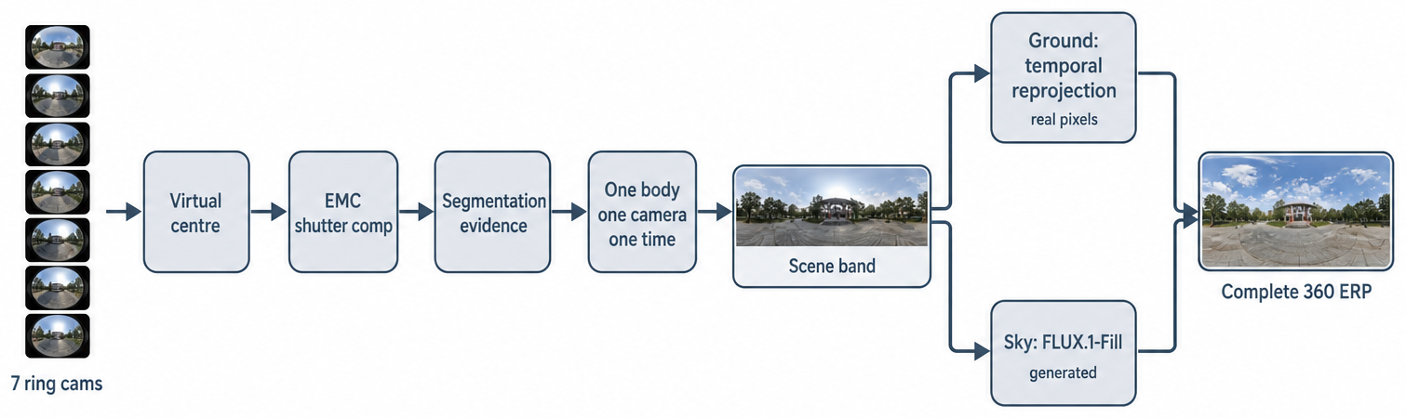
MAIN METHOD · 2/2
The full pipeline
Rule zero: never average geometry — every pixel comes from exactly one camera at one instant; where evidence is insufficient, fall back honestly (abstain).
Scene band first; then the sphere is completed: ground by temporal reprojection (real pixels), sky by FLUX.1-Fill (the only generated layer).
VIII
Notes:
1. The previous slide argued that knowledge conflict is the real bottleneck. This slide shows the paper’s methodology turning that bottleneck into a usable signal.
2. On the left, Figure 2 gives the intuition. Earlier RAG poisoning attacks can already write misleading passages, but when the model has strong internal knowledge, many of those passages still fail to flip the answer.
3. So the question is no longer just how to write poison. The deeper question is: where inside the model does poisoned context actually start to win?
4. That is what Poison-Responsive Neurons, or PRNs, are for. PRNs are the neurons whose activations change the most when poisoned retrieved context is present.
5. They are not the attack itself. They are the internal markers of where poisoned context is getting traction inside the model.
6. On the right is how the paper computes them. The baseline x-prime is query only, and x is query plus retrieved context.
7. Integrated Gradients then measures how much each neuron's activation changes after we add the retrieved context on top of the query-only baseline. For each sample, the method keeps the top-k most responsive neurons, and then aggregates them across samples into a reusable global top-r PRN set.
8. So Poison Responsive Neurons does not generate poisoned passages yet. It first extracts a compact internal target, and the next slide shows how the genetic algorithm optimizes passages against that target.

Slide 9
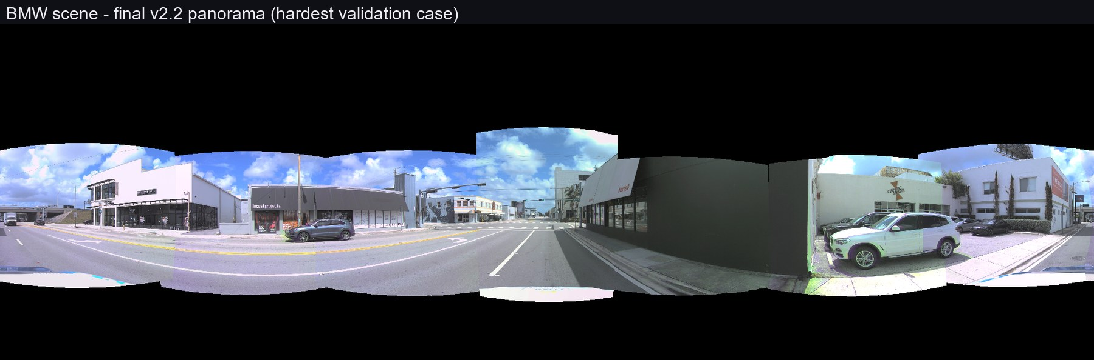
RESULTS
Scene band: source-faithful across 5 scenes, zero per-scene parameters
▸ All user-visible defect classes closed on the hardest scene; residuals adjudicated as real source content
▸ Same code, no tuning: bmw / downtown / crowd / clean / highway
▸ Graceful no-LiDAR degradation: the moving car still renders intact (same OMC du = +6)
IX
Notes:
1. For evaluation, the paper uses four open-source LLMs they are LLaMA-2-7B-chat · Vicuna-7B v1.5 · Vicuna-13B v1.5 · Gemma-7B, three QA datasets , SQuAD 2.0 · TriviaQA · WikiQA , and ten generations of search on A100 GPUs.
2. The main metric is POSR, Population Overwrite Success Rate, which measures the fraction of passages that flip the model to the target false answer.
3. Stealthiness is tracked with perplexity.
4. And the main comparison baseline is PoisonedRAG

Slide 10
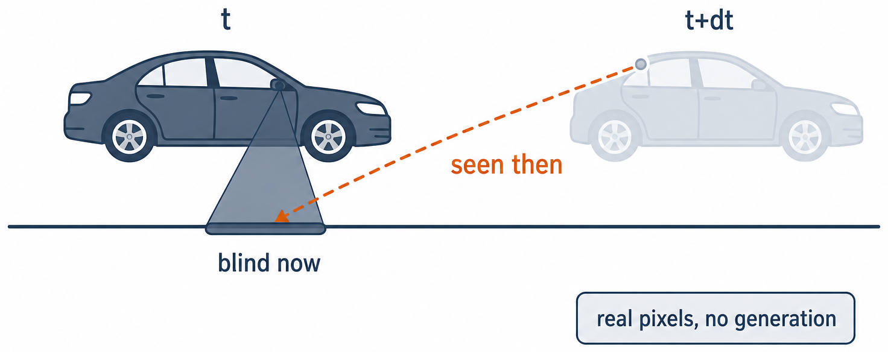
COMPLETING THE SPHERE · GROUND
Ground: not generated — reprojected from time
The road under the car NOW was fully visible to the cameras seconds earlier / later → deterministic reprojection of real pixels (94.5–100% coverage, lane lines continuous through the nadir, ego hood geometrically removed).
▸ Candidate frames chosen by geometry over the whole log (a fixed time window fails when the ego idles at a light)
▸ Exact ray test removes the source car's own hood / cabin reflections
▸ Nadir rendered at the evidence's true optical resolution — nothing invented
X
Notes:
1. This slide shows the main result from Table 1 across three datasets and four models.
2. The initial GPT-4 seeds are only moderately effective, with Initial POSR around 0.41 to 0.48. After the neuron-guided genetic optimization, Final POSR rises to about 0.88 to 0.95. That is the main pattern.
3. By comparison, PoisonedRAG, the compared baseline, stays much lower, mostly around 0.49 to 0.62. So the improvement is not only large, but also very consistent across all twelve dataset-model pairs.
4. The Relative Perplexity Drop is also modest, which means the optimized passages do not become less natural. If anything, they often become slightly more fluent.
5. One thing to keep in mind is that this table reports POSR at the population level. The next slide switches to ASR under the same initialized templates, which is a stricter comparison.

Slide 11
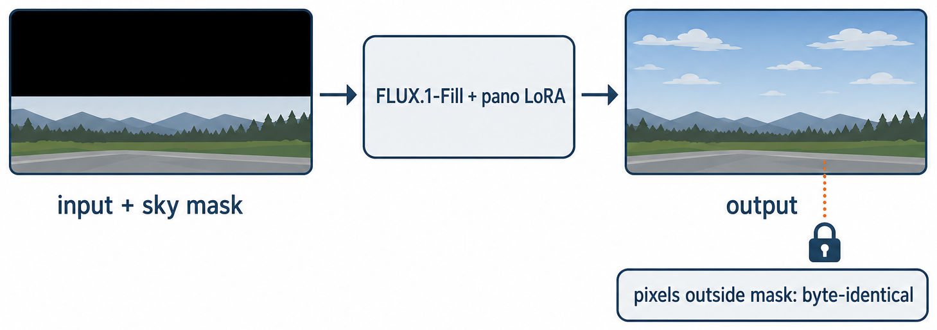
COMPLETING THE SPHERE · SKY
Sky: the only generated layer
INPUT
MODEL
OUTPUT
scene-band panorama + sky mask (the only evidence-free region)
→
FLUX.1-Fill (mask-conditioned inpainting) + DiT360 panorama LoRA (ERP geometry only)
→
complete sphere; every pixel outside the mask byte-identical to input
▸ FLUX.1-Fill is the engine — continuation of observed clouds is its training objective; DiT360's only role is its panorama LoRA
▸ Auto-prompt (sunny / dusk / overcast) chosen from observed sky-band statistics — 5/5 scenes correct
XI
Notes:
1. The previous slide was the paper's main result under POSR, which is a population-level metric.
2. This slide asks a stricter follow-up question: if we start from the same initialized templates as PoisonedRAG and look at ASR instead, does the paper’s method still remain competitive?
3. Here the paper starts from the same initialized templates as PoisonedRAG.
4. Even under this stricter setup, paper’s method still matches or slightly exceeds PoisonedRAG across the four models.
5. So the benefit is not only higher average population success. The method is also competitive when both attacks start from the same templates, and it stays stable for different values of r.

Slide 12
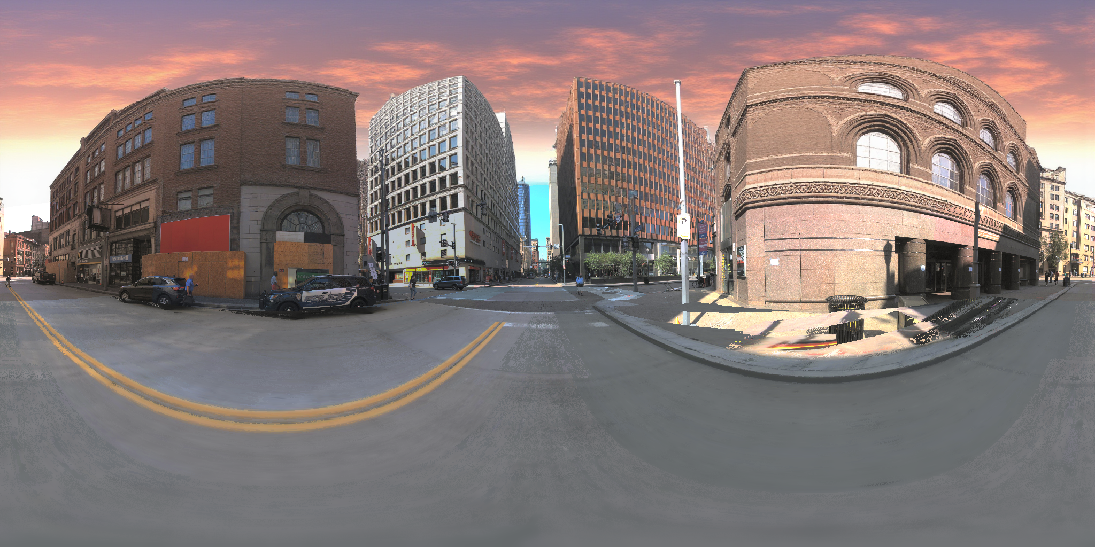
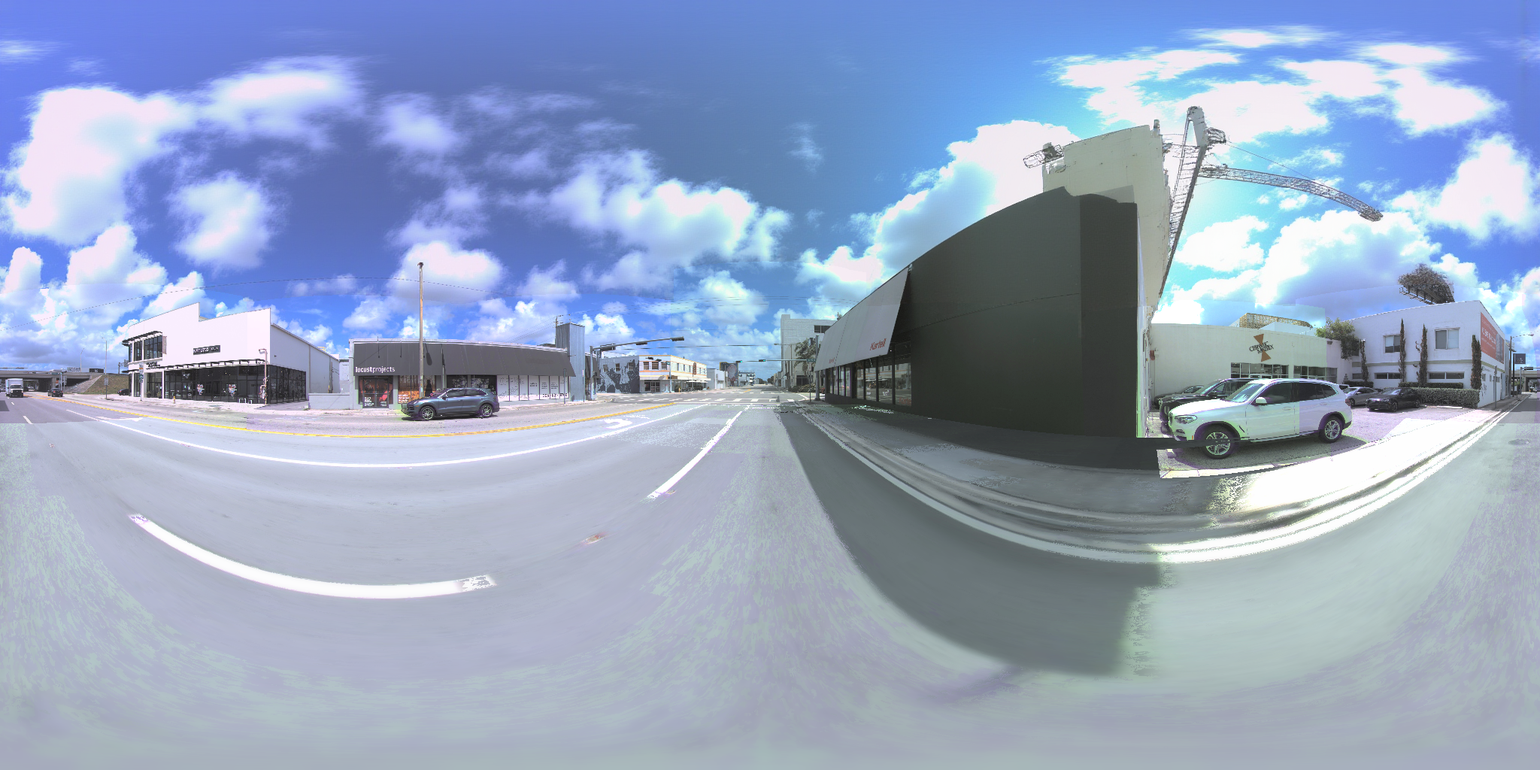
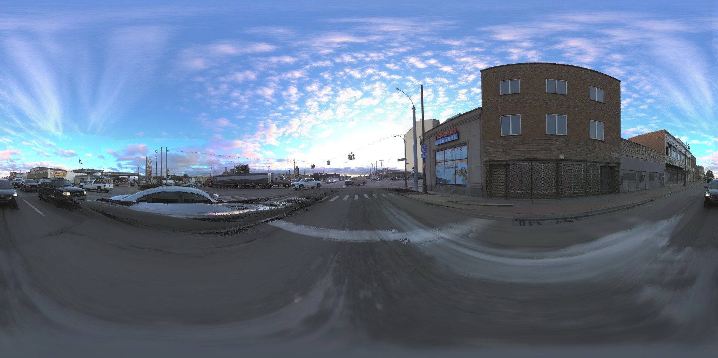
FINAL RESULTS
Complete spheres, multi-weather
XII
bmw sunny cumulus · downtown auto-detected dusk · highway altocumulus continuation — scene band & ground 100% real pixels; sky is the only generated region.
Notes:
Why does this work?
1. Figures 2 and 3 give the paper's answer. Figure 2, on the top, shows the behavioral side: as genetic optimization proceeds, POSR keeps rising across generations. More and more queries move from partial overwrite toward consistently successful overwrite.
2. Figure 3, shows the internal side: the Poison-Responsiveness Score, also rises across generations.
3. These two trends rise together. So the genetic algorithm is not just wandering through text space randomly. It is being guided by a neuron-level signal that closely tracks attack success.

Slide 13
CLOSING
Principles & next
PRINCIPLES
NEXT
▸ Source-faithful: never invent geometry
▸ Evidence-gated: every pixel has a provenance — real (scene band, ground) vs generated (sky only)
▸ Abstain honestly where evidence ends
▸ Waymo migration — the generalization gate
▸ Centre contract with the world-model first-frame consumer
▸ Dataset scaling: 75-panorama AV2 set already produced
XIII
Notes:
1. The ablation also matters.
2. Here, GA-PRS and GA-Sim use the same genetic algorithm setting. The only difference is the fitness function.
3. GA-Sim is the similarity-guided variant. It scores each candidate passage by the cosine similarity between the query and the candidate external knowledge, so it does not use any neuron signal.
4. GA-PRS is the full neuron-guided variant. It scores each candidate by the Poison-Responsiveness Score over the selected top-r Poison-Responsive Neurons.
5. Across all four models, GA-PRS keeps improving and reaches above 90 percent by generation 10, while GA-Sim stays around 40 to 50 percent with little progress.
6. So the takeaway is that GA alone is not enough. In this ablation, the neuron-guided fitness is the main driver of the gain.

